Slide 1
SwiftLog Logistics
Supply Chain Analytics and Business Intelligence
Presentation | Week 5 Data Analytics Track
Adeyemo Taiwo Aminat, Junior Data Analyst
Notes:
Introduce yourself and the project: you were asked to turn SwiftLog's raw logistics data into a Power BI dashboard that helps management decide faster.

Slide 2
Business overview
SwiftLog is a fast-growing Nigerian logistics company. Growth has created delays, stock imbalances and little visibility for management.
5,000
1,000
250
15
orders (Jan to 8 Sep 2026)
customers in 4 cities
products in 3 categories
warehouses (Lagos, Abuja, Kano)
Cities served: Lagos, Abuja, Kano and Ibadan. Categories: Fashion, Food and Electronics.
2

Slide 3
Project objectives
Monitor business performance
Improve delivery efficiency
Improve inventory management
1
2
3
Evaluate supplier performance
Reduce product returns
Support executive decisions
4
5
6
3

Slide 4
Data preparation process
1
2
3
4
5
Import
Clean
Model
Measure
Visualise
11 SwiftLog datasets loaded into Power BI
Data types set, date fields (year, month, quarter) created
Tables linked by order, customer, product, shipment and warehouse keys
16 DAX measures built for KPIs
5 interactive dashboard pages
Data notes: 3 duplicate inventory rows and 100 products without a supplier record were identified and flagged.
4

Slide 5
Dashboard demonstration: five interactive pages
Executive Summary
Revenue and order trends, delivery status, KPI cards, city and quarter slicers
Customer Analysis
Top customers, customers and orders by city, growth trend
Inventory and Warehouse
Stock by category and warehouse location, turnover, lowest stock
Shipment and Delivery
Delivery status, delays by location, shipment volume trend
Supplier and Product
Best sellers, revenue by product, price comparison, category slicer
5
Notes:
Live demo or screenshots: open each page in turn and show one slicer interaction and one cross-filter.

Slide 6
KPI summary: sales are healthy, delivery is not
21.67M
4,334
3.57 days
Total revenue
Average order value
Average delivery delay
36.3%
10%
0.08
On-time delivery rate
Return rate (500 returns)
Inventory turnover
6

Slide 7
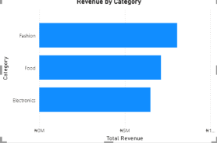
Insight 1: revenue is balanced, led by Fashion
Fashion 37.2%
Food 32.8%
Electronics 30.0%
Top 5 products make up only 4.2% of revenue, so sales are spread across a wide range of products.
7

Slide 8
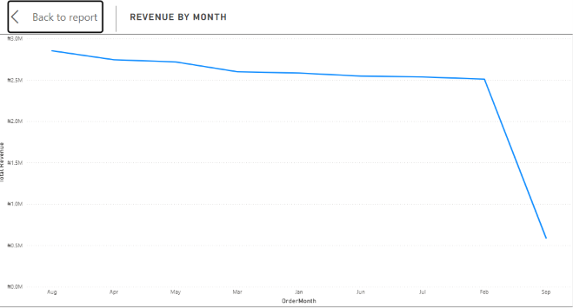
Insight 2: August is the peak month
August: 626 orders
April and May follow
Q2 is the strongest quarter (8.00M).
September data ends on 8 Sep, so it is left out.
8

Slide 9
Insight 3: nearly two in three shipments are late
1,701
delayed shipments in Lagos, 53% of all delays
Delays occur in every region and warehouse.
9

Slide 10
Insight 4: most returns and stock problems are fixable
63%
of returns are wrong or damaged items, which SwiftLog controls
12x
more stock than recent demand needs (turnover 0.08)
10

Slide 11
Key business recommendations
Fix delivery
Weekly delay root-cause log; start with Lagos
Rebalance staff
W14, W15, W12 handle 34 to 38 shipments per employee vs about 20 at W13, W03
1
2
Right-size stock
Set reorder points; move surplus to low-stock sites
Supplier scorecards
Improve Suppliers 60, 73, 47, 104; learn from 85 and 65
3
4
Cut returns
Pick-and-pack checks and better packaging
Fix cancellations
Investigate the 32.5% cancelled and 34.3% pending orders
5
6
Retain top customers
Loyalty programme for the top 100 (22% of revenue)
Grow Fashion and Ibadan
Promote top products; lift Ibadan spend per customer
7
8
11

Slide 12
Expected business impact (suggested targets)
36% to 50%
10% to 8%
Lower
Less
on-time delivery, about 680 fewer late shipments
return rate, about 100 fewer returns
cancelled and pending orders, more completed sales
cash tied up in excess stock
Targets are illustrative goals based on current volume, for management to confirm. Weekly dashboard reviews of on-time rate, cancellations, returns, supplier scores and staffing ratios will track progress.
12

Slide 13
Conclusion
SwiftLog has a strong commercial base: balanced categories, loyal repeat customers and steady demand.
Its biggest risks are operational: late deliveries, cancelled orders, avoidable returns and excess stock.
Fix delivery first, starting with Lagos, then clear the order backlog and introduce supplier and warehouse scorecards.
Thank you. Questions?

